Slide 1
GREEDY ALGORITHM

Slide 2
Definition
01
Working mechanism
02
Table of contents
03
Characteristics
04
Applications

Slide 3
1.
Definition
What is Greedy algorithm?

Slide 4
What is Greedy Algorithm?
Step 1
Step 2
Step n
locally optimal choice
locally optimal choice
locally optimal choice
global optimal choice

Slide 5
Discuss
What problems have you encountered that applied the Greedy algorithm?

Slide 6
2.
Working mechanism
Basic structure and complexity

Slide 7
Return the money
Return a given amount of money using the least possible number of bills
Amount of money: 26 000 VND
Possible number of bills: 10 000 VND
5 000 VND
2 000 VND
1 000 VND

Slide 8
26 000 VND
10 000 VND
2
5 000 VND
1
2 000 VND
0
1 000 VND
1

Slide 9
Basic structure
Step 1: Define the problem & all possible solutions (for each step)
Step 2: Determine the benefit or value of each solution
Step 3: Select the solution with maximum benefit or value
Step 4: Repeat until the solution is complete

Slide 10
Discuss
Why are Greedy algorithms usually fast?

Slide 11
Time complexity
1. Best choice at each step
This significantly reduces the number of options and computations required
2. No requirement for exhaustive search
It focuses on the solution at each step without revisiting or revaluating previous decisions

Slide 12
Time complexity
Is considered to be moderate
Depends on the specific problem and the specific implementation of the algorithm
Normally: O(n log n), O(n)

Slide 13
On each step, the choice made must be
1. Feasible
Satisfy the problem’s constraints
2. Locally optimal
The best local choice among all feasible choices available on that step
3. Irrevocable
Cannot be changed on subsequent steps

Slide 14
Return the money
Return a given amount of money using the least possible number of bills
Amount of money: 6 000 VND
Possible number of bills: 4 000 VND
3 000 VND
1 000 VND

Slide 15
6 000 VND
4 000 VND
1
3 000 VND
0
1 000 VND
2
4 000 VND
0
3 000 VND
2
1 000 VND
0

Slide 16
3.
Characteristics
Limitations, advantages, conditions

Slide 17
Limitations
1. Inability to backtrack
Lack of consideration for future steps
2. Suboptimality
Not always produce the optimal solution
3. Limited scope
Is only suitable for a number of problems

Slide 18
Discuss
Why is the Greedy algorithm widely used, especially in the field of computer science?

Slide 19
Advantages
Simple, easy to understand and implement
Faster and more efficient
Does not require large memory
Easy to combine with other algorithms
Offers a good approximation

Slide 20
Discuss
When do greedy algorithms give optimal results?

Slide 21
Conditions for using Greedy algorithm
1. Optimal substructure property
The solution is divisible into smaller parts
2. Greedy choice property
The locally optimal choice should always lead to the globally optimal solution

Slide 22
4. Applications of Greedy algorithm

Slide 23
Applications of Greedy algorithm
Constructing Minimum Spanning Trees
Implement Huffman Encoding
Solve Optimization Problems

Slide 24
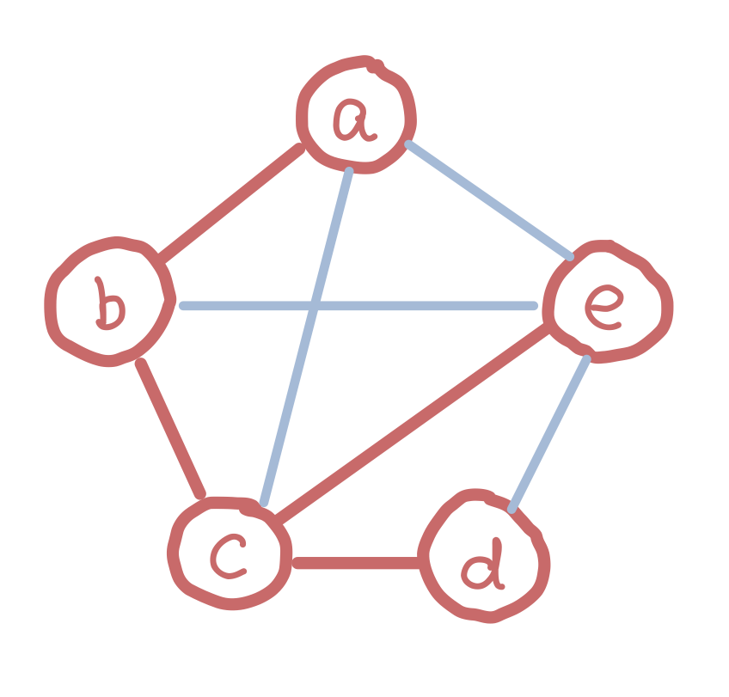
Constructing Minimum Spanning Trees
What is a spanning tree?

Slide 25
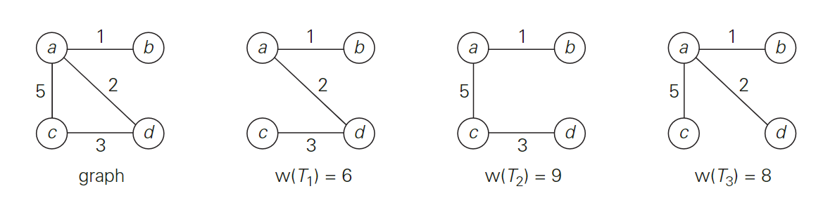
Instance of minimum spanning tree
Graph and its spanning trees, with $T_{1}$ being the minimum spanning tree.

Slide 26
Constructing Minimum Spanning Trees
A minimum spanning tree is its spanning tree of the smallest weight, where the weight of a tree is defined as the sum of the weights on all its edges.
Find a minimum spanning tree?

Slide 27
Solution for minimum spanning tree
Prim’s algorithm
Constructs a minimum spanning tree through a sequence of expanding subtrees. On each iteration, the algorithm expands the current tree in the greedy manner by simply attaching to it the nearest vertex not in that tree.
Kruskal’s algorithm
Constructs a minimum spanning tree as an expanding sequence of subgraphs (add the edge has smallest weight) that are always acyclic but are not necessarily connected on the intermediate stages of the algorithm.

Slide 28
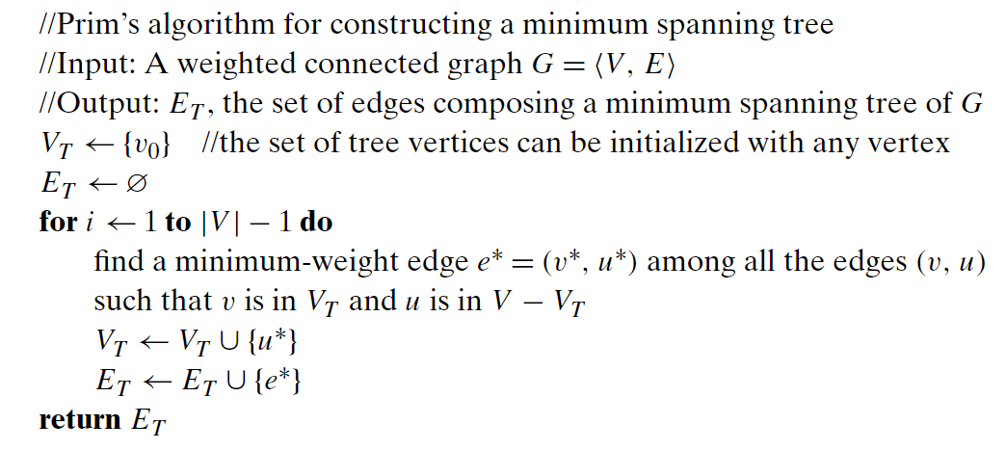
Pseudocode of Prim’s algorithm

Slide 29
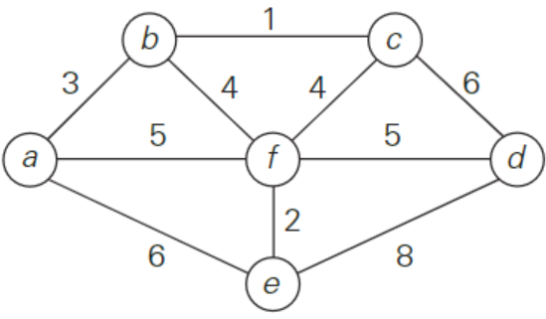
Example of Prim’s algorithm

Slide 30
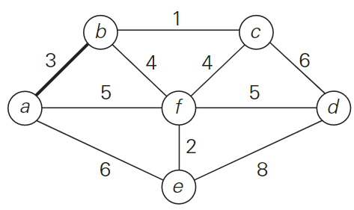
Example of Prim’s algorithm

Slide 31
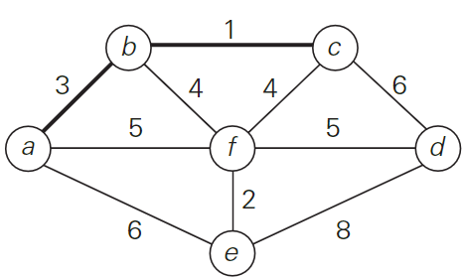
Example of Prim’s algorithm

Slide 32
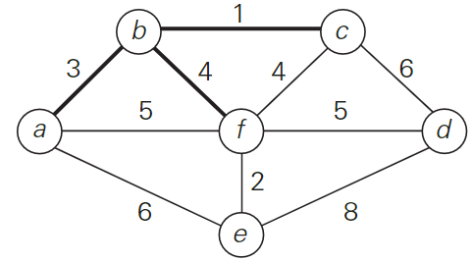
Example of Prim’s algorithm

Slide 33
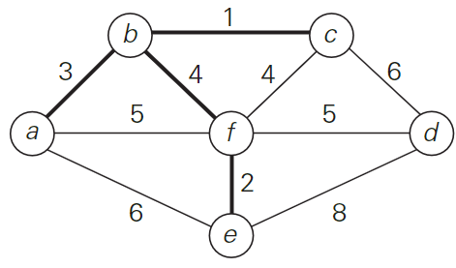
Example of Prim’s algorithm

Slide 34
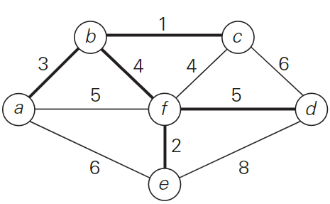
Example of Prim’s algorithm

Slide 35
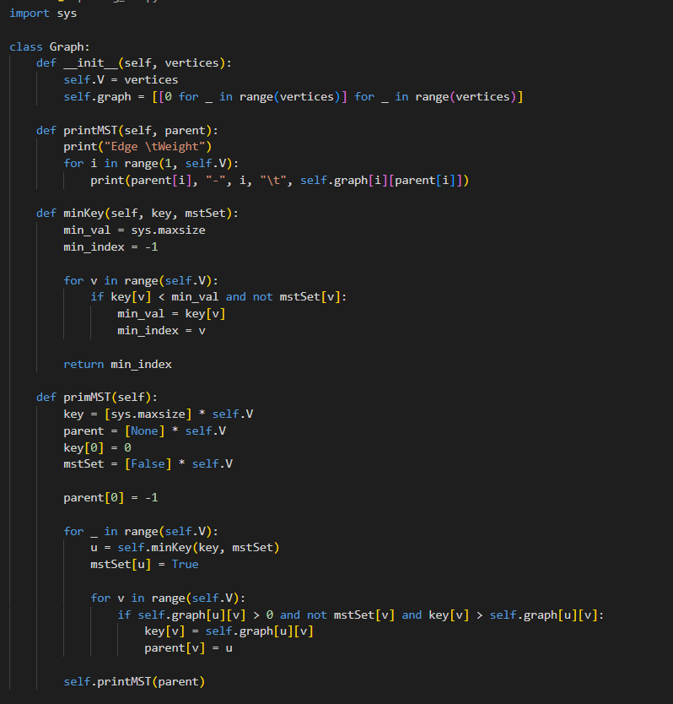
Code
Python
for
Prim’s
algorithm

Slide 36
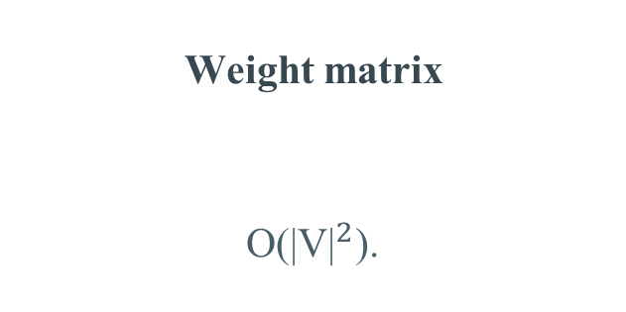
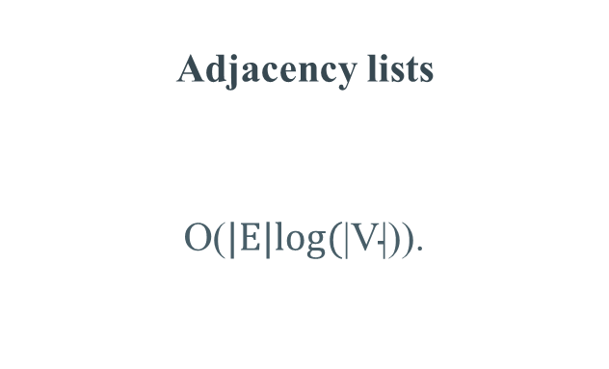
Time complexity of Prim’s algorithm
V is the set of vertices in the graph
E is the set of edges in the graph
Weight matrix
O(${\text{|}\text{V}\text{|}}^{2}$).
Adjacency lists
O($\text{|}\text{E}\text{|}\text{log}\text{(}\text{|}\text{V}\text{|)}$).

Slide 37
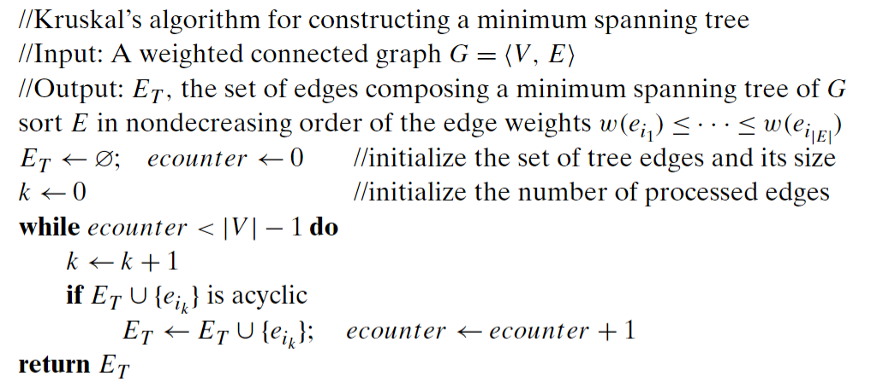
Pseudocode of Kruskal’s algorithm

Slide 38
Instance of Kruskal’s algorithm

Slide 39
Example of Kruskal’s algorithm

Slide 40
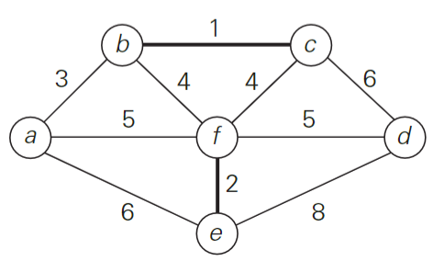
Example of Kruskal’s algorithm

Slide 41
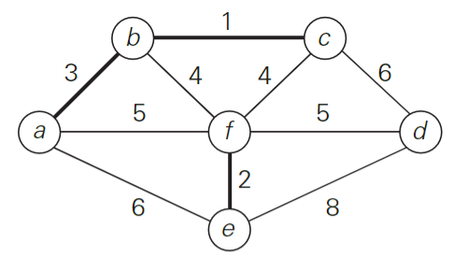
Example of Kruskal’s algorithm

Slide 42
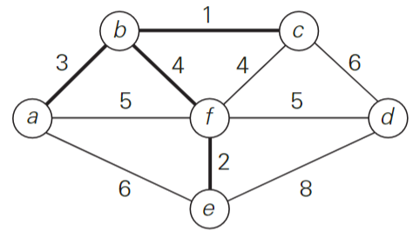
Example of Kruskal’s algorithm

Slide 43
Example of Kruskal’s algorithm

Slide 44
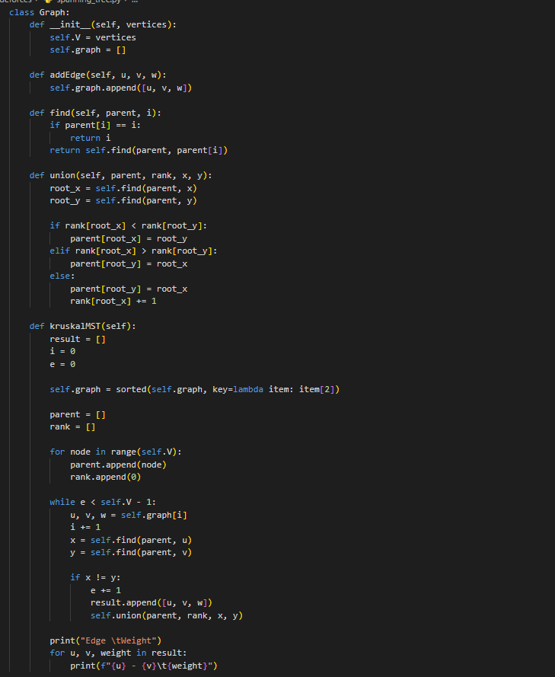
Code
Python
for
Kruskal’s
algorithm

Slide 45
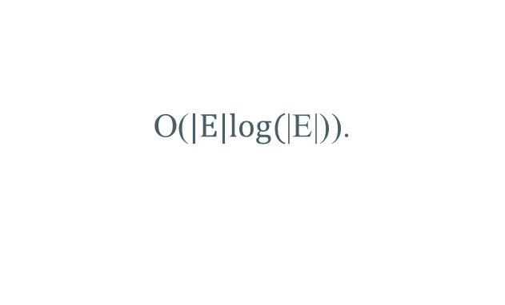
Time complexity of Kruskal’s algorithm
V is the set of vertices in the graph
E is the set of edges in the graph
O($\text{|}\text{E}\text{|}\text{log}\text{(}\text{|}\text{E}\text{|)}$).

Slide 46
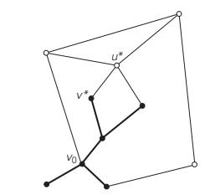
Single-source shortest-paths problem
What is the single-source shortest-paths problem?

Slide 47
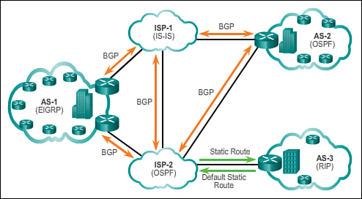
Single-source shortest-paths problem

Slide 48
Dijkstra’s algorithm
Step 1: Set a source vertex distance as 0, and all other vertices as unvisited with a distance of infinity.
Step 2: Pick the unvisited vertex C with the smallest distance and visit it.
Step 3: The current vertex x, distances of its with min(d(C) + W(C, x), d(x)).
Repeat steps 2 and 3 until all vertices are visited, or the target vertex is reached (if specified).

Slide 49
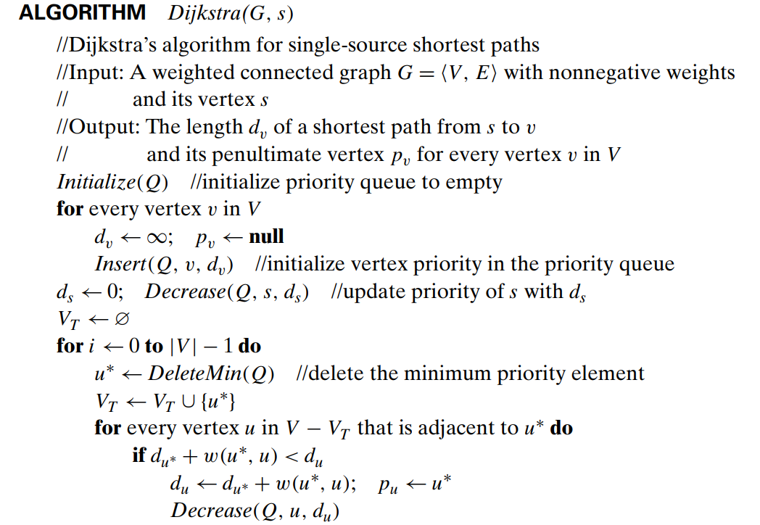
Pseudocode of Dijkstra’s algorithm

Slide 50
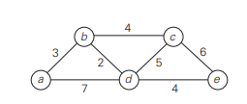
Example of Dijkstra’s algorithm

Slide 51
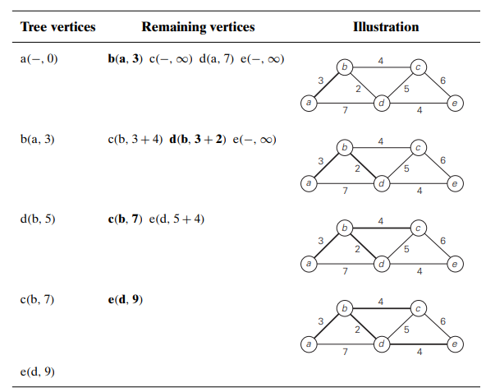
Example of Dijkstra’s algorithm

Slide 52
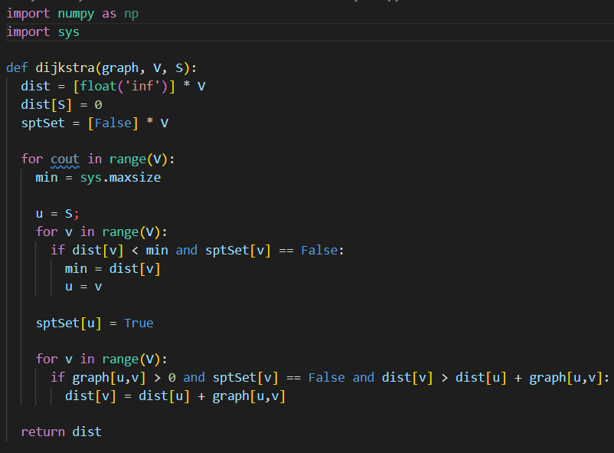
Code
Python
for
Dijkstra’s
algorithm

Slide 53
Discuss
The application of the Greedy algorithm in cyber security

Slide 54

Data security in the cloud environment
What is the Data security?

Slide 55
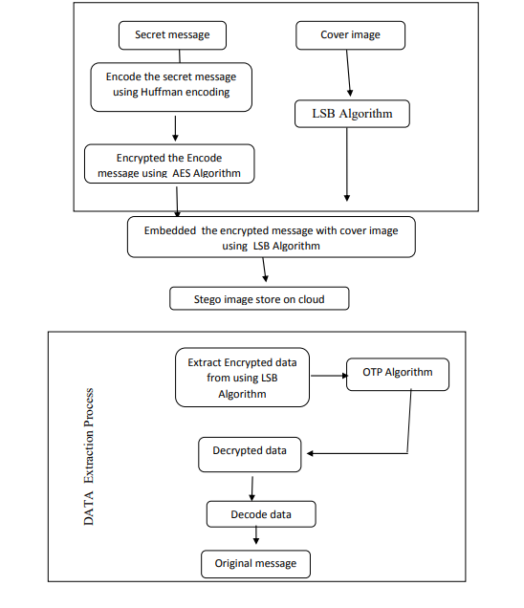
Methodology

Slide 56

Huffman’s Coding
What is the Huffman’s Coding?

Slide 57
Huffman’s Coding
Step 1: Calculate symbol frequencies.
Step 2: Create a binary tree using the frequencies. Combine two nodes with the lowest frequencies to create a new internal node
Step 3: Assign binary codes to each symbol based on the tree structure.
Step 4: Replace each symbol with its binary code

Slide 58
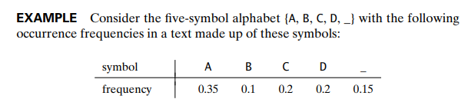
Example of Huffman’s Coding.

Slide 59
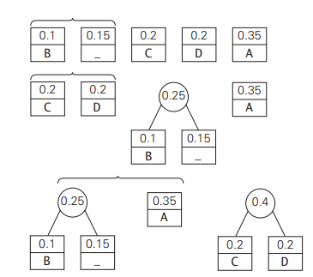
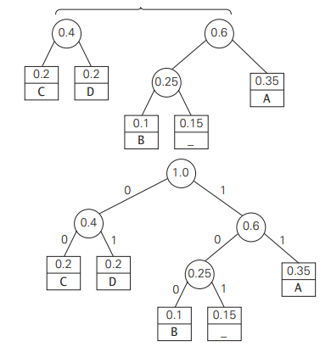
Example of Huffman’s Coding.

Slide 60
Example of Huffman’s Coding.

Slide 61
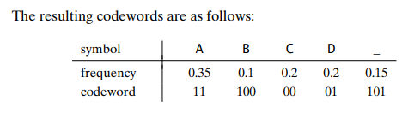
Example of Huffman’s Coding.
With text: ‘DAD’ is encoded ‘011101’
And code: ‘1001101101011101’ is decoded ‘BAD_DAD’

Slide 62
Thanks!
Any questions?

Slide 63
REFERENCE
Books: The Design and Analysis of Algorithms
Paper: DATA SECURITY BASED ON CRYPTOGRAPHY, STEGANOGRAPHY COMBINED WITH OTP ALGORITHM AND HUFFMAN CODING IN THE CLOUD ENVIRONMENT (Ms. K Brindhashree, Dr. Sinthu Janita Prakash)

Slide 64
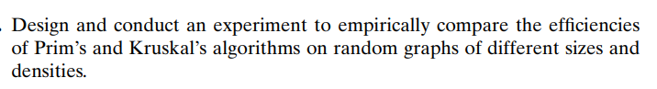
HOMEWORK 1

Slide 65
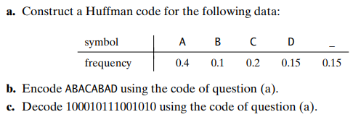
HOMEWORK 2

